Slide 1

Green Pace
Security Policy Presentation
Developer: Courtney Warner
CS 405 Secure Coding
Southern New Hampshire University
06/21/2025

Slide 2

OVERVIEW: DEFENSE IN DEPTH
The Green Pace Security Policy ensures all software development follows secure, standardized practices. It defines coding standards, encryption, and access controls for all staff involved in creating or supporting applications. Aligned with the defense-in-depth model, the policy layers protections across systems, from governance to endpoint security, helping safeguard critical assets even if one layer is compromised.

Slide 3
THREATS MATRIX
High-priority and likely threats pose the greatest risk to system integrity and must be addressed first. Low-priority and unlikely threats still require mitigation but pose less immediate danger. This matrix helps prioritize secure coding efforts to align with our defense-in-depth strategy.
Likely STD-003-CPP: String storage STD-004-CPP: SQL injection STD-005-CPP: Memory leak STD-008-CPP: Use after free STD-009-CPP: Null pointer | Priority STD-007-CPP: Exceptions STD-010-CPP: Mismatched new/delete
Low priority STD-001-CPP: Multiple declarations STD-006-CPP: Assertions | Unlikely STD-001-CPP: Multiple declarations STD-006-CPP: Assertions

Slide 4
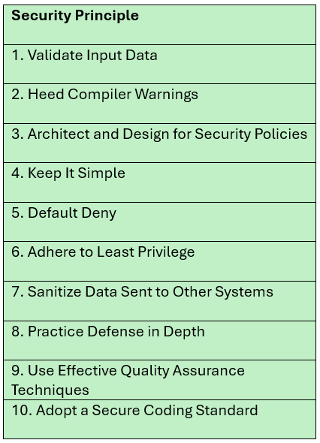
10 PRINCIPLES

Slide 5
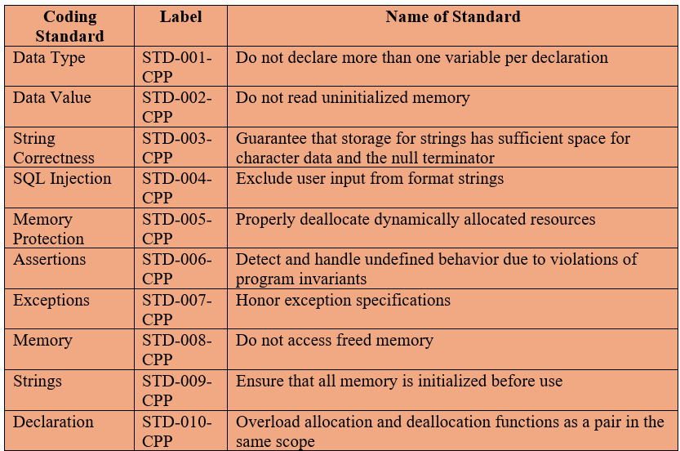

CODING STANDARDS

Slide 6
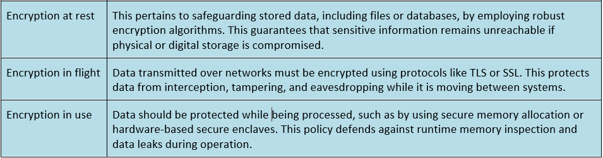
ENCRYPTION POLICIES

Slide 7
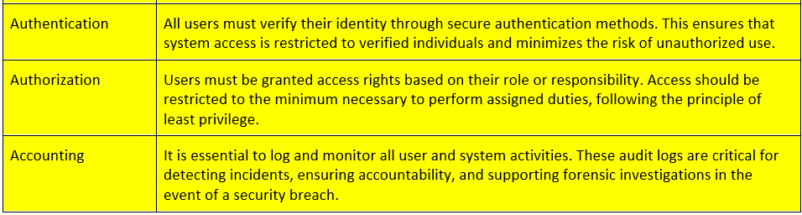

TRIPLE-A POLICIES

Slide 8
Unit Testing CollectionTest.CanAddToEmptyVector
Vulnerability Tested: Data validation and safe memory access
Explanation: This test ensures that your vector correctly allows data insertion when it starts empty. It confirms that your code properly handles initialization and can safely add values without crashing.
Why it matters: Adding to an empty collection is a common scenario where improper memory handling (like null dereferencing or capacity issues) could lead to crashes or undefined behavior.
Security Risk If Not Tested: A failure here could mean memory corruption or denial-of-service (DoS) from crashes when a collection operation is improperly handled.

Slide 9
Unit Testing CollectionTest.ResizeToZeroClearsCollection
Vulnerability Tested: Memory management and cleanup Explanation: This test checks whether resizing a collection to zero effectively clears the memory it holds.
Why it matters: This confirms proper cleanup of dynamic memory and ensures no data leakage.
Security Risk If Not Tested: Failure to properly clear memory could lead to stale or sensitive data lingering in memory, posing a data leakage vulnerability.

Slide 10
Unit Testing CollectionTest.ThrowsWhenAccessingOutOfBounds
Vulnerability Tested: Bounds checking (memory protection) Explanation: This test confirms that attempting to access an element outside the valid index range throws an appropriate exception.
Why it matters: This defends against buffer overflow and out-of-bounds access, which are serious vulnerabilities often exploited in cyberattacks.
Security Risk If Not Tested: Without this test, an attacker could deliberately access invalid memory, possibly leading to crashes, data corruption, or arbitrary code execution.

Slide 11
Unit Testing CollectionTest.AlwaysFail
What it Tests
This test is designed to intentionally fail, usually for one of two purposes:
Confirm that the test framework reports failures correctly
Simulate a code path that would violate an expected condition, such as incorrect logic, failed assertions, or unsafe state.

Slide 12

AUTOMATION SUMMARY
Automation embeds security into every phase of the DevSecOps lifecycle.
In pre-production, it supports secure architecture, vulnerability scanning, and verifying trusted builds.
In production, it enables continuous monitoring, automated threat response, and scheduled penetration testing, helping teams stay secure without slowing development.

Slide 13
TOOLS FOR AUTOMATION “DevSecOps is an approach to culture, automation, and platform design that integrates security as a shared responsibility throughout the entire IT lifecycle.” -IBM Cloud Education
Parasoft C/C++test - For: Design, Verifying and Testing, Transitioning and Health Checks, Maintaining and Stabilizing
Purpose: Automated unit and compliance testing with static/dynamic analysis.
Cppcheck - For: Building, Verifying, and Testing
Purpose: Detects bugs and coding issues early with static code analysis.
Clang Static Analyzer - For: Building, Designing
Purpose: Compiler-based tool that flags undefined behavior and memory errors.

Slide 14
RISKS AND BENEFITS
Risks of waiting:
Data breaches and loss
Damage to customer trust and brand reputation
Increased financial and legal liability
Difficulty recovering from multiple or persistent threats
Benefits of early action:
Reduce vulnerability exposure
Strengthen infrastructure and defenses
Save on future remediation costs
Streamline security and testing through automation
What steps should be taken:
While early investment in security may incur initial costs and planning, it is far less expensive than the fallout from data breaches. Proactive security reduces long-term risk, improves resilience, and builds customer trust.

Slide 15
RECOMMENDATIONS
Regularly review and update the policy to close emerging gaps.
Schedule annual assessments by an external security firm.
Apply security measures early in development to reduce risks.
Define concrete actions for the “Respond” phase of post-production.
Specify which tools and repositories should be used in the build phase.
Clarify how policy enforcement will be handled beyond automation.

Slide 16
CONCLUSIONS
By integrating security throughout the development lifecycle, this policy reinforces a proactive DevSecOps strategy. Secure coding standards, static analysis tools, and automated enforcement measures help detect vulnerabilities early, reduce risk, and ensure compliance. Through continuous testing, monitoring, and incident response readiness, our team can maintain a strong security posture and deliver resilient software with confidence.

Slide 17
REFERENCES
Foster, S. (2021, January 22). DevSecOps pipeline overview: DevSecOps simplified. Perforce Software. Retrieved from https://www.perforce.com/blog/kw/devsecops-pipeline-overview
Marsal, J. (2023, January 19). What is DevSecOps? Dynatrace. https://www.dynatrace.com/news/blog/what-is-devsecops/ (Updated April 8, 2025)
Tools References:
CPPCheck: static code analysis https://cppcheck.sourceforge.io/
Clang: front-end compiler https://clang.llvm.org/
Parasoft: automated testing suite https://www.parasoft.com/

